Slide 1
Lesson objective
Title: Parallelograms and Trapeziums
Aim:
Calculate the area of parallelograms and trapeziums.
Plan:
Review formula
Shapes and formula relationships

Slide 2
What is the name of this shape?
A. Trapezium
B. Rectangle
C. Parallelogram
D. Triangle

Slide 3
What is the formula for the area of a rectangle?
A. Length x height x ½
B. 2 x length x width
C. Length x width
D. Height + length

Slide 4
What is the area of this rectangle?
3cm
5cm
A. 8cm²
B. 15cm²
C. 15cm
D. 16cm

Slide 5
What is the area of this rectangle?
8m
10m
A. 80m²
B. 36m²
C. 18m
D. 80cm²

Slide 6
The area of this rectangle is 20cm². What is the length of side ‘x’?
Area = 20cm²
4cm
x
A. 80cm²
B. 5cm
C. 16cm
D. 5cm²

Slide 7
The area of this rectangle is 56m². what is the length of the side marked ‘x’?
Area = 56m²
x
8m
A. 48m
B. 64m
C. 7m²
D. 7m

Slide 8
What is the measurement marked ‘x’ called?
x
Base
A. Length
B. Height
C. Depth
D. Width

Slide 9
What is the missing word in the formula?
Area of a triangle =
½ x ??? x height
A. Length
B. Width
C. Depth
D. Base

Slide 10
What is the area of this triangle?
6cm
8cm
A. 24cm²
B. 14cm
C. 48cm
D. 48cm²

Slide 11
What is the area of this triangle?
5mm
8mm
A. 40mm²
B. 20cm²
C. 20mm²
D. 13mm²

Slide 12
What is the area of this triangle?
4m
12m
A. 48m²
B. 96m²
C. 16m²
D. 24m²

Slide 13
The area of this triangle is 45cm². What is the length of side ‘x’?
9cm
Area = 45cm²
X
A. 36cm
B. 10cm
C. 5cm
D. 5cm²

Slide 14
The area of this triangle is 20mm². What is the height marked ‘x’?
X
Area = 20mm²
10mm
A. 8mm
B. 2mm
C. 4mm
D. 5mm

Slide 15
What is the area of this triangle?
6m
6m
5m
7m
A. 17.5m²
B. 15m²
C. 18m²
D. 21m²

Slide 16
Area of a Parallelogram and Trapezium
Investigation:
What is the area of this rectangle?
4cm
6cm

Slide 17
Area of a Parallelogram and Trapezium
Investigation:
Cut the shape like this
4cm
6cm

Slide 18
Area of a Parallelogram and Trapezium
Investigation:
What is the area of this rectangle?

Slide 19
Area of a Parallelogram and Trapezium
Investigation:
Cut the shape like this

Slide 20
Area of a Parallelogram and Trapezium
Investigation:
What is the area of this parallelogram
4cm
6cm

Slide 21
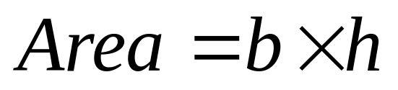

Area of a Parallelogram and Trapezium
Formula:
The formula for the area of a parallelogram is:
Height (h)
Base (b)

Slide 22

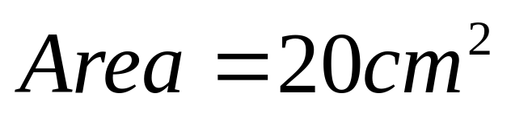
Area of a Parallelogram and Trapezium
Example:
Find the area of this parallelogram
4cm
5cm

Slide 23

Activity 1:
1
Find the area of the following parallelograms
a
b
c
d
15cm²
3cm
3cm
7mm
5m
13.5cm²
49mm²
8m
40m²
5cm
7mm
4.5cm
2
Find the missing lengths of these parallelograms when given the area
a
b
c
d
a
4cm
7cm
18mm²
24cm²
5cm
35cm²
c
46cm²
d
4.6cm
4mm
4.5mm
6cm
b
10cm
Below illustrates a garden which needs to be seeded with grass. The grass seeds costs £8.50 per packet and covers 15m².
Work out the cost to cover the garden with grass seeds.
40m²
5m
3 packs
8m
£25.50

Slide 24
Area of a Parallelogram and Trapezium
Investigation:
Here are two trapeziums that are the same
A
B
A
h
B
A
B

Slide 25
Area of a Parallelogram and Trapezium
Investigation:
Here are two trapeziums that are the same
A
B
h
B
A

Slide 26
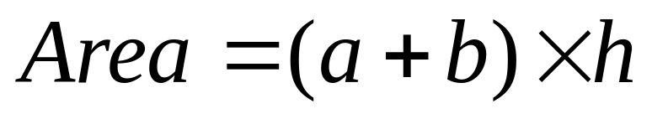
Area of a Parallelogram and Trapezium
Investigation:
Creates a Parallelogram
A
B
h
B
A

Slide 27
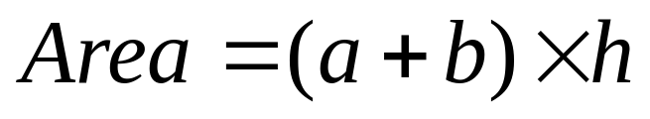
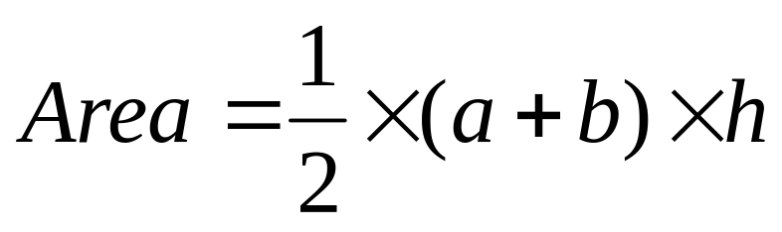
Area of a Parallelogram and Trapezium
Investigation:
Creates a Parallelogram
A
B
However area of the trapezium is half the size:
h
B
A

Slide 28

Area of a Parallelogram and Trapezium
Formula:
The formula for the area of a trapezium is:
a
Height (h)
Area = ½ the parallel sides times by the distance between the two sides
b

Slide 29
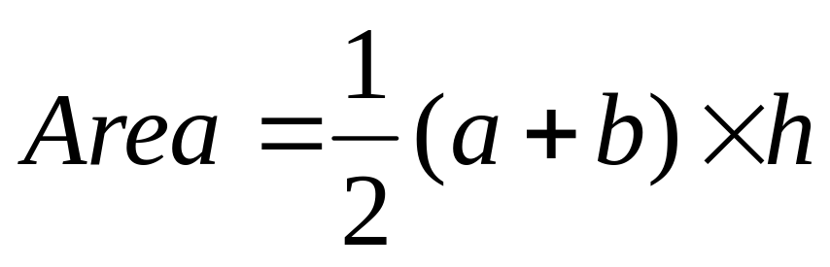
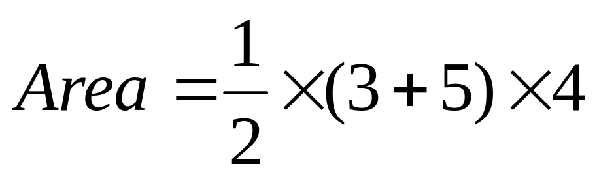
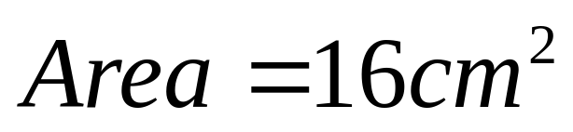
Area of a Parallelogram and Trapezium
Example:
Find the area of this trapezium.
3cm
4cm
5cm

Slide 30
Activity 2:
1
Find the area of the following trapeziums
6cm
7mm
5m
a
b
c
d
30mm²
35m²
4m
14m²
5cm
6mm
5m
3m
35cm²
8cm
3mm
9m
4m
2
Find the missing lengths of these trapeziums when given the area
4cm
5m
8mm
a
b
c
a
40cm²
7m
49m²
8cm
b
4mm
7mm
42mm²
6cm
9m
c
3
Find the shaded area of the rectangle
15cm
6cm
5cm
6cm
4cm
5cm
8cm
10cm
35cm
426cm²

Slide 31
What is the name of this shape?
A. Trapezium
B. Rectangle
C. Parallelogram
D. Triangle

Slide 32
How do you work out the area of a parallelogram?
Height
Base
A. Base x height
B. Base + length
C. ½ x base x height
D. 2(base + height)

Slide 33
What is the area of this parallelogram?
5cm
12cm
A. 60cm
B. 60cm²
C. 30cm
D. 30cm²

Slide 34
What is the area of this parallelogram?
7m
2m
A. 14cm
B. 9cm²
C. 7m²
D. 14m²

Slide 35
The area of this parallelogram is 40cm². What is the length of side ‘x’?
5cm
Area = 40cm²
X
A. 10cm²
B. 8cm
C. 4cm
D. 10cm

Slide 36
What is the name of this shape?
A. Trapezium
B. Rectangle
C. Parallelogram
D. Triangle

Slide 37
Which pair of sides are parallel?
b
a
c
d
A. a and b
B. b and d
C. b and c
D. a and c

Slide 38
What is missing from the instructions?
To find the area of a trapezium:
Add the parallel sides
Divide by 2
????? the height
A. Subtract
B. Divide
C. Multiply by
D. Add

Slide 39
What is the area of this trapezium?
To find area of a trapezium:
Add the parallel sides
Divide by 2
Multiply by the height
3cm
4cm
7cm
A. 28cm²
B. 12cm²
C. 40cm²
D. 20cm²

Slide 40
What is the area of this trapezium?
10m
To find area of a trapezium:
Add the parallel sides
Divide by 2
Multiply by the height
5m
4m
A. 35m²
B. 20m²
C. 50m²
D. 70m²

Slide 41
The area of this trapezium is 35cm². What is the height ‘x’?
6cm
To find area of a trapezium:
Add the parallel sides
Divide by 2
Multiply by the height
X
Area = 35cm²
8cm
A. 10cm
B. 5cm
C. 2.5cm
D. 7cm

